Slide 1
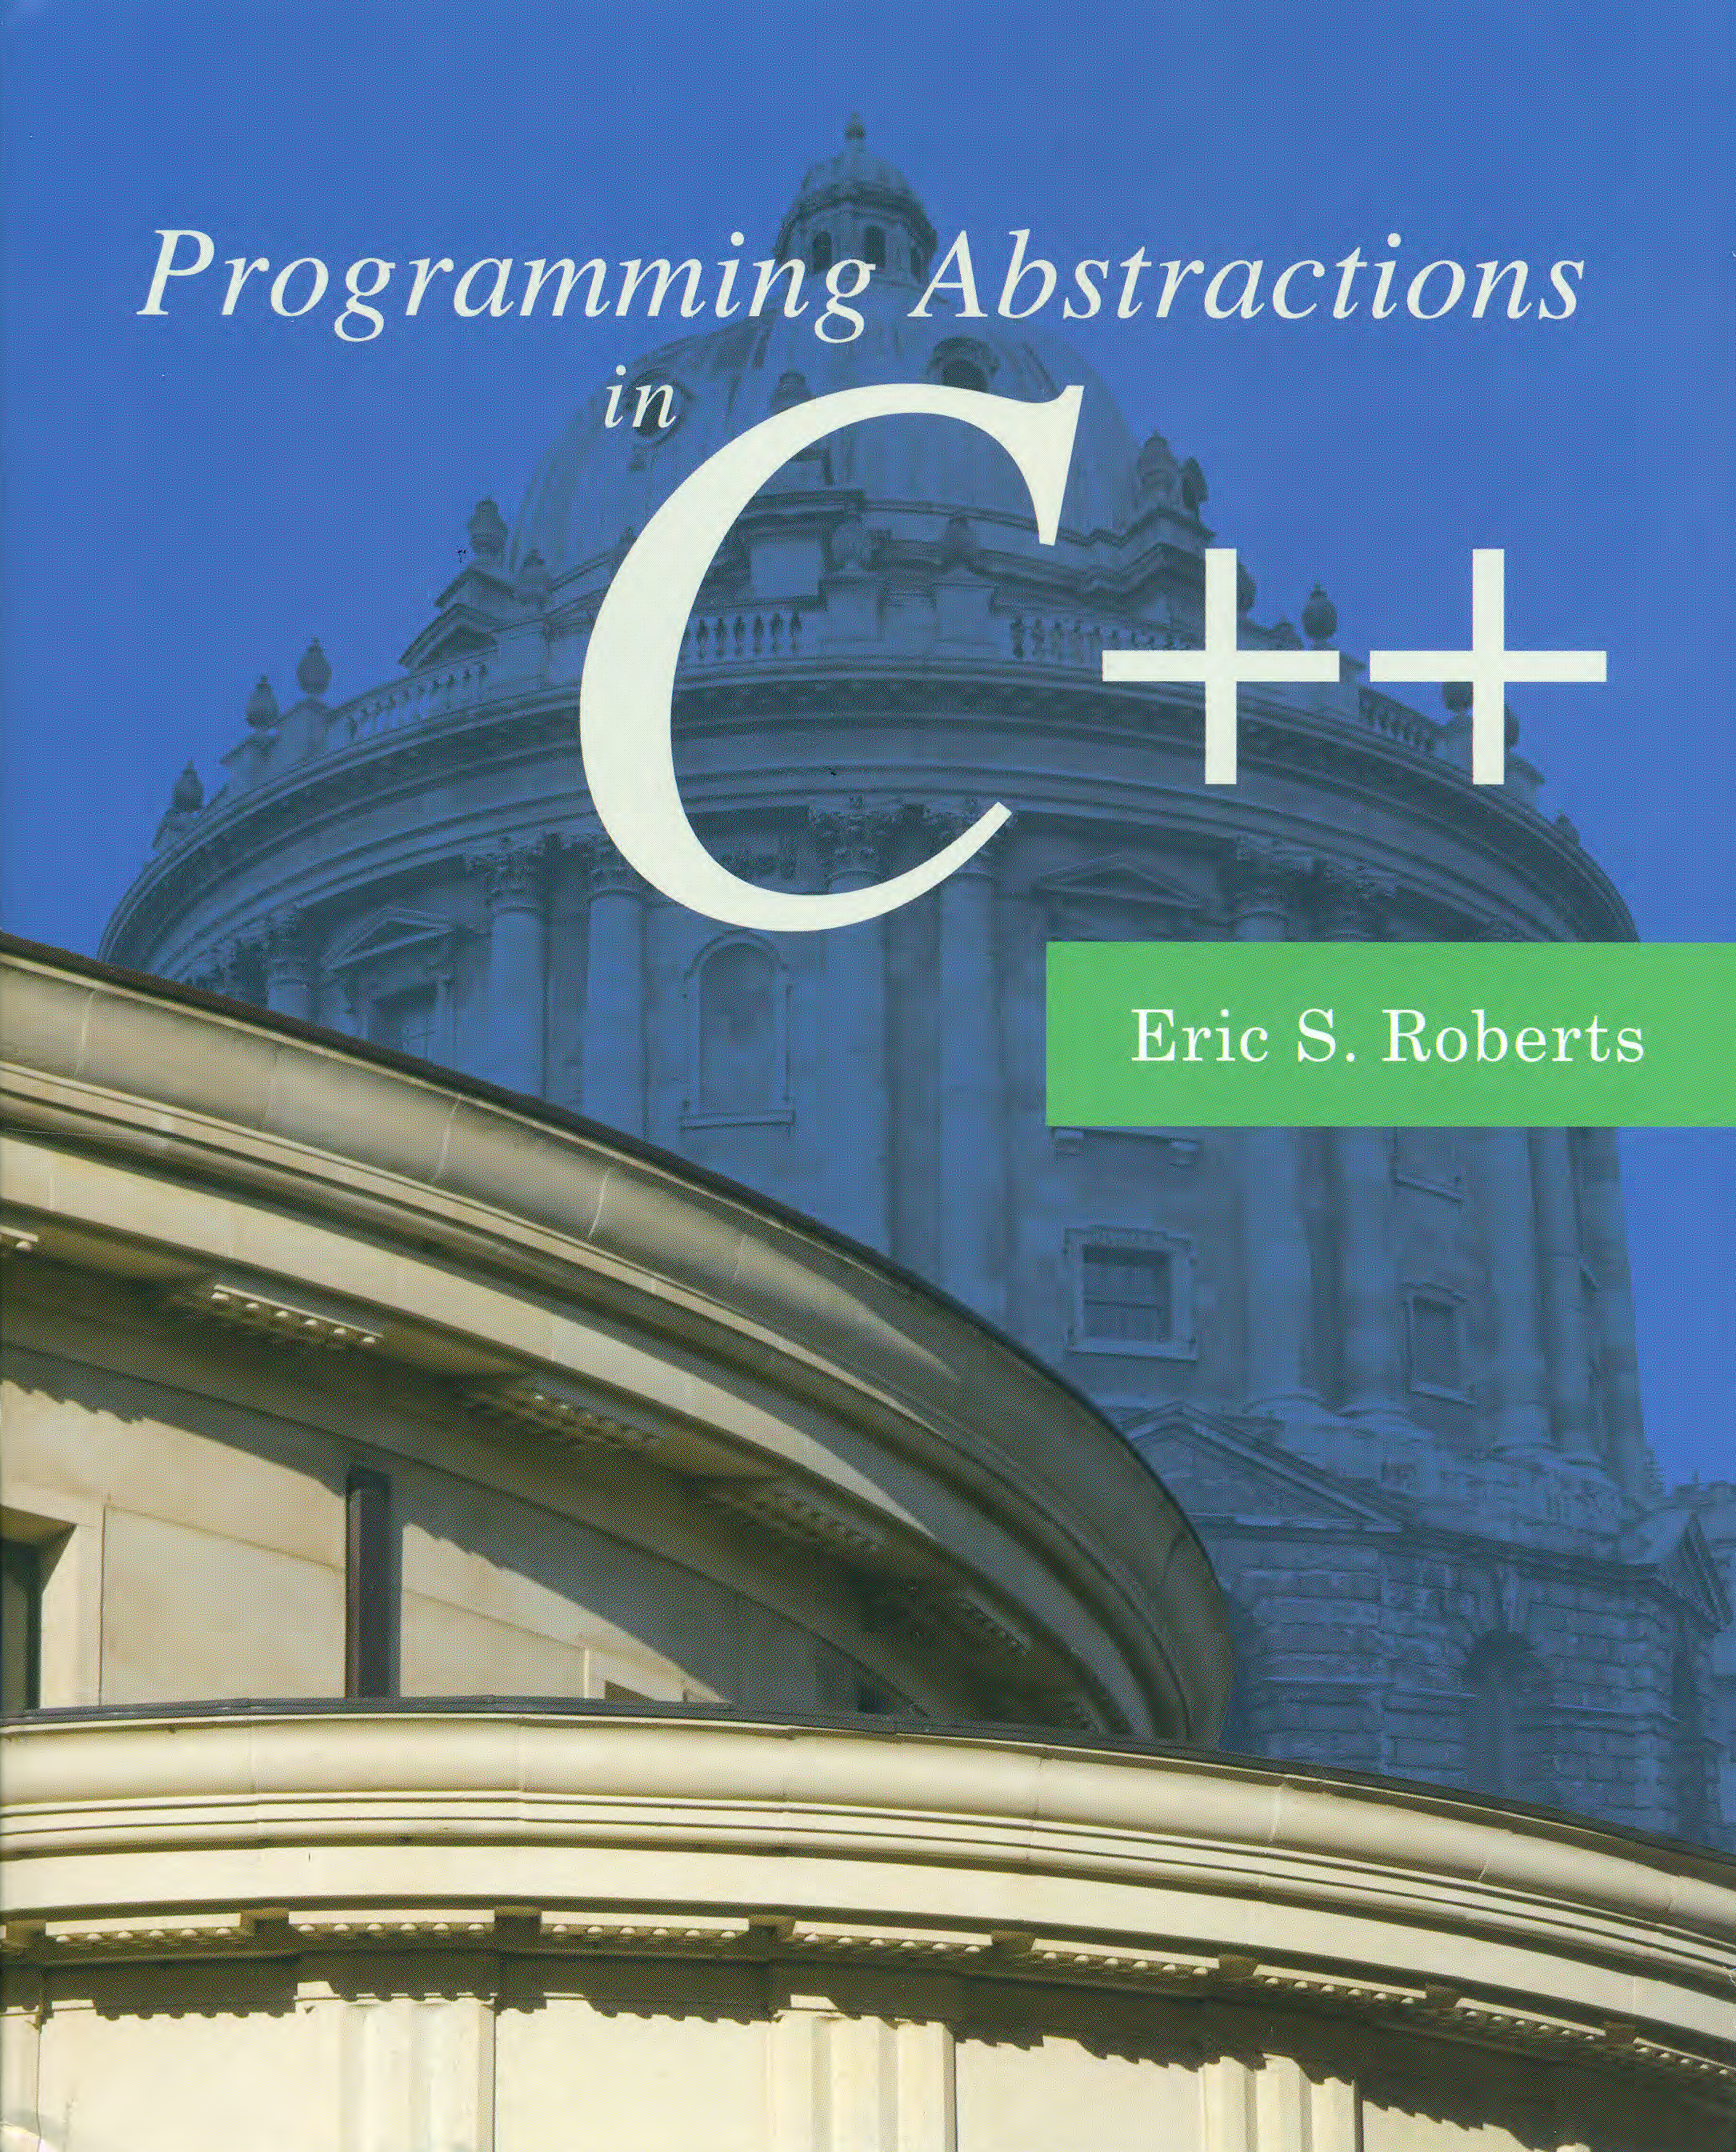
Efficiency and Representation
C H A P T E R 13
Time granted does not necessarily coincide with time that can be most fully used.
—Tillie Olsen, Silences, 1965
13.1 Software patterns for editing text
13.2 Designing a simple text editor
13.3 A stack-based implementation
13.4 An array-based implementation
13.5 A list-based implementation

Slide 2
Software Patterns for Editing Text
Most editors today follow the WYSIWYG principle, which is an acronym for “what you see is what you get” that keeps the screen updated so that it shows the current document.
Before WYSIWYG editors existed, most editors used a command-line model. To edit a document, you enter commands that consist of a letter, possibly along with some additional data.
Rather than showing the contents of the editor all the time, command-line editors showed the contents only when the user asked for them.

Slide 3
Why Look at Old Editors?
The editor in the text uses the command-line model because:
It’s the best example of how using different data representations can have a profound effect on performance.
No modern editor is simple enough to understand in its entirety.
Command-line editors, e.g., TECO (Text Editor and COrrector), are historically important as the first extensible editors, and the basis of EMACS, which is still in use today.
The strategies used to representing the editor buffer persist in modern editor classes, such as Java’s JEditorPane.

Slide 4
The Editor Commands
Our minimal version of TECO has the following commands:
Itext
Inserts the text following the I into the buffer.
J
Jumps the current point (the cursor) to the beginning.
E
Moves the cursor to the end of the buffer.
F
Moves the cursor forward one character.
B
Moves the cursor backward one character.
D
Deletes the character after the cursor.
H
Prints a help message listing the commands.
Q
Quits from the editor.

Slide 5
Methods in the EditorBuffer Class
buffer.moveCursorForward()
Moves the cursor forward one character (does nothing if it’s at the end).
buffer.moveCursorBackward()
Moves the cursor backward one character (does nothing if it’s at the beginning).
buffer.moveCursorToStart()
Moves the cursor to the beginning of the buffer.
buffer.moveCursorToEnd()
Moves the cursor to the end of the buffer.
buffer.insertCharacter(ch)
Inserts the character ch at the cursor position and advances the cursor past it.
buffer.deleteCharacter()
Deletes the character after the cursor, if any.
buffer.getText()
Returns the contents of the buffer as a string.
buffer.getCursor()
Returns the position of the cursor.

Slide 6
The buffer.h Interface
/*
* File: buffer.h
* --------------
* This file defines the interface for an editor buffer class.
*/
#ifndef _buffer_h
#define _buffer_h
class EditorBuffer {
public:
/*
* Constructor: EditorBuffer
* -------------------------
* Creates an empty editor buffer.
*/
EditorBuffer();
/*
* Destructor: ~EditorBuffer
* -------------------------
* Frees any storage associated with this buffer.
*/
~EditorBuffer();

Slide 7
The buffer.h Interface
/*
* Methods: moveCursorForward, moveCursorBackward
* Usage: buffer.moveCursorForward();
* buffer.moveCursorBackward();
* -----------------------------------
* These functions move the cursor forward or backward one
* character, respectively. If you call moveCursorForward
* at the end of the buffer or moveCursorBackward at the
* beginning, the function call has no effect.
*/
void moveCursorForward();
void moveCursorBackward();
/*
* Methods: moveCursorToStart, moveCursorToEnd
* Usage: buffer.moveCursorToStart();
* buffer.moveCursorToEnd();
* --------------------------------
* These functions move the cursor to the start or the end of this
* buffer, respectively.
*/
void moveCursorToStart();
void moveCursorToEnd();
/*
* File: buffer.h
* --------------
* This file defines the interface for an editor buffer class.
*/
#ifndef _buffer_h
#define _buffer_h
class EditorBuffer {
public:
/*
* Constructor: EditorBuffer
* -------------------------
* Creates an empty editor buffer.
*/
EditorBuffer();
/*
* Destructor: ~EditorBuffer
* -------------------------
* Frees any storage associated with this buffer.
*/
~EditorBuffer();

Slide 8
The buffer.h Interface
/*
* Method: insertCharacter
* Usage: buffer.insertCharacter(ch);
* ----------------------------------
* This function inserts the single character ch into this
* buffer at the current cursor position. The cursor is
* positioned after the inserted character, which allows
* for consecutive insertions.
*/
void insertCharacter(char ch);
/*
* Method: deleteCharacter
* Usage: buffer.deleteCharacter();
* --------------------------------
* This function deletes the character immediately after
* the cursor. If the cursor is at the end of the buffer,
* this function has no effect.
*/
void deleteCharacter();
/*
* Methods: moveCursorForward, moveCursorBackward
* Usage: buffer.moveCursorForward();
* buffer.moveCursorBackward();
* -----------------------------------
* These functions move the cursor forward or backward one
* character, respectively. If you call moveCursorForward
* at the end of the buffer or moveCursorBackward at the
* beginning, the function call has no effect.
*/
void moveCursorForward();
void moveCursorBackward();
/*
* Methods: moveCursorToStart, moveCursorToEnd
* Usage: buffer.moveCursorToStart();
* buffer.moveCursorToEnd();
* --------------------------------
* These functions move the cursor to the start or the end of this
* buffer, respectively.
*/
void moveCursorToStart();
void moveCursorToEnd();

Slide 9
The buffer.h Interface
/*
* Method: getText
* Usage: string str = buffer.getText();
* -------------------------------------
* Returns the contents of the buffer as a string.
*/
std::string getText() const;
/*
* Method: getCursor
* Usage: int cursor = buffer.getCursor();
* ---------------------------------------
* Returns the index of the cursor.
*/
int getCursor() const;
}
#endif
/*
* Method: insertCharacter
* Usage: buffer.insertCharacter(ch);
* ----------------------------------
* This function inserts the single character ch into this
* buffer at the current cursor position. The cursor is
* positioned after the inserted character, which allows
* for consecutive insertions.
*/
void insertCharacter(char ch);
/*
* Method: deleteCharacter
* Usage: buffer.deleteCharacter();
* --------------------------------
* This function deletes the character immediately after
* the cursor. If the cursor is at the end of the buffer,
* this function has no effect.
*/
void deleteCharacter();
Private section goes here.

Slide 10
Where Do We Go From Here?
Our goal from this point is to implement the EditorBuffer class in three different ways and to compare the algorithmic efficiency of the various options. Those representations are:
A two-stack model that uses a pair of character stacks.
A simple array model using dynamic allocation.
A linked-list model that uses pointers to indicate the order.
For each model, we’ll calculate the complexity of each of the six fundamental methods in the EditorBuffer class. Some operations will be more efficient with one model, others will be more efficient with a different underlying representation.

Slide 11
The Two-Stack Model
In the two-stack implementation of the EditorBuffer class, the characters in the buffer are stored in one of two stacks. The characters before the cursor are stored in a stack called before and the characters after the cursor are stored in a stack called after. Characters in each stack are stored so that the ones close to the cursor are near the top of the stack.
For example, given the buffer contents
the characters would be stored like this:
a b c d e
c
b
d
a
e
before
after

Slide 12
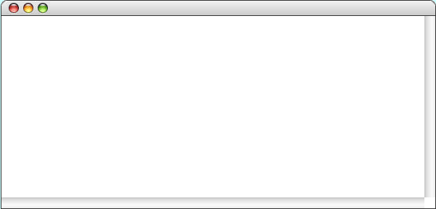
Stack Editor Simulation
*
Iacxde
a c x d e
^
*
J
a c x d e
^
*
F
a c x d e
^
e
*
Ib
a b c x d e
d
^
*
F
x
a b c x d e
^
c
*
b
D
a b c d e
^
a
*
before
after

Slide 13
Private Data for Stack-Based Buffer
private:
/*
* Implementation notes: Buffer data structure
* -------------------------------------------
* In the stack-based buffer model, the characters are stored in two
* stacks. Characters before the cursor are stored in a stack named
* "before"; characters after the cursor are stored in a stack named
* "after". In each case, the characters closest to the cursor are
* closer to the top of the stack. The advantage of this
* representation is that insertion and deletion at the current
* cursor position occurs in constant time.
*/
#include "charstack.h"
/* Instance variables */
CharStack before; /* Stack of characters before the cursor */
CharStack after; /* Stack of characters after the cursor */

Slide 14
Stack-Based Buffer Implementation
/*
* File: buffer.cpp (stack version)
* --------------------------------
* This file implements the EditorBuffer class using a pair of
* stacks to represent the buffer. The characters before the
* cursor are stored in the before stack, and the characters
* after the cursor are stored in the after stack.
*/
#include <iostream>
#include "buffer.h"
using namespace std;
/*
* Implementation notes: EditorBuffer constructor/destructor
* ---------------------------------------------------------
* In this representation, the implementation of the CharStack class
* automatically takes care of allocation and deallocation.
*/
EditorBuffer::EditorBuffer() {
/* Empty */
}
EditorBuffer::~EditorBuffer() {
/* Empty */
}

Slide 15
Stack-Based Buffer Implementation
/*
* Implementation notes: moveCursor methods
* ----------------------------------------
* These methods use push and pop to transfer values between the two stacks.
*/
void EditorBuffer::moveCursorForward() {
if (!after.isEmpty()) {
before.push(after.pop());
}
}
void EditorBuffer::moveCursorBackward() {
if (!before.isEmpty()) {
after.push(before.pop());
}
}
void EditorBuffer::moveCursorToStart() {
while (!before.isEmpty()) {
after.push(before.pop());
}
}
void EditorBuffer::moveCursorToEnd() {
while (!after.isEmpty()) {
before.push(after.pop());
}
}
/*
* File: stackbuf.cpp
* ------------------
* This file implements the EditorBuffer class using a pair of
* stacks to represent the buffer. The characters before the
* cursor are stored in the before stack, and the characters
* after the cursor are stored in the after stack.
*/
#include <iostream>
#include "buffer.h"
using namespace std;
/*
* Implementation notes: EditorBuffer constructor/destructor
* ---------------------------------------------------------
* In this representation, the implementation of the CharStack class
* automatically takes care of allocation and deallocation.
*/
EditorBuffer::EditorBuffer() {
/* Empty */
}
EditorBuffer::~EditorBuffer() {
/* Empty */
}

Slide 16
Stack-Based Buffer Implementation
/*
* Implementation notes: moveCursor methods
* ----------------------------------------
* These methods use push and pop to transfer values between the two stacks.
*/
void EditorBuffer::moveCursorForward() {
if (!after.isEmpty()) {
before.push(after.pop());
}
}
void EditorBuffer::moveCursorBackward() {
if (!before.isEmpty()) {
after.push(before.pop());
}
}
void EditorBuffer::moveCursorToStart() {
while (!before.isEmpty()) {
after.push(before.pop());
}
}
void EditorBuffer::moveCursorToEnd() {
while (!after.isEmpty()) {
before.push(after.pop());
}
}
/*
* Implementation notes: insertCharacter and deleteCharacter
* ---------------------------------------------------------
* Each of the functions that inserts or deletes characters
* can do so with a single push or pop operation.
*/
void EditorBuffer::insertCharacter(char ch) {
before.push(ch);
}
void EditorBuffer::deleteCharacter() {
if (!after.isEmpty()) {
after.pop();
}
}

Slide 17
The Array Model
Conceptually, the simplest strategy for representing the editor buffer is to use an array for the individual characters.
To ensure that the buffer can contain an arbitrary amount of text, it is important to allocate the array storage dynamically and to expand the array whenever the buffer runs out of space.
The array used to hold the characters will contain elements that are allocated but not yet in use, which makes it necessary to distinguish the allocated size (capacity) of the array from its effective size (count).
In addition to the size and capacity information, the data structure for the editor buffer must contain an additional integer variable that indicates the current position of the cursor. This variable can take on values ranging from 0 up to and including the length of the buffer.

Slide 18
Array Editor Simulation
*
Iacxde
count
a c x d e
0
5
^
6
*
J
capacity
a c x d e
8
^
*
F
a c x d e
cursor
0
5
0
1
2
^
3
*
Ib
a b c x d e
array
^
*
F
a b c x d e
^
a
c
c
b
x
x
d
d
e
e
d
e
*
D
a b c d e
^
0
1
2
3
4
5
6
7
*

Slide 19
Private Data for Array-Based Buffer
private:
/*
* Implementation notes: Buffer data structure
* -------------------------------------------
* In the array-based implementation of the buffer, the characters in the
* buffer are stored in a dynamic array. In addition to the array, the
* structure keeps track of the capacity of the buffer, the length of the
* buffer, and the cursor position. The cursor position is the index of
* the character that follows where the cursor would appear on the screen.
*/
/* Constants */
static const int INITIAL_CAPACITY = 10;
/* Instance variables */
char *array; /* Dynamic array of characters */
int capacity; /* Allocated size of that array */
int length; /* Number of character in buffer */
int cursor; /* Index of character after cursor */
/* Private method prototype */
void expandCapacity();

Slide 20
Array-Based Buffer Implementation
/*
* File: buffer.cpp (array version)
* --------------------------------
* This file implements the EditorBuffer class using an array representation.
*/
#include <iostream>
#include "buffer.h"
using namespace std;
/*
* Implementation notes: Constructor and destructor
* ------------------------------------------------
* The constructor initializes the private fields. The destructor
* frees the heap-allocated memory, which is the dynamic array.
*/
EditorBuffer::EditorBuffer() {
capacity = INITIAL_CAPACITY;
array = new char[capacity];
length = 0;
cursor = 0;
}
EditorBuffer::~EditorBuffer() {
delete[] array;
}

Slide 21
Array-Based Buffer Implementation
/*
* Implementation notes: moveCursor methods
* ----------------------------------------
* The four moveCursor methods simply adjust the value of the
* cursor instance variable.
*/
void EditorBuffer::moveCursorForward() {
if (cursor < length) cursor++;
}
void EditorBuffer::moveCursorBackward() {
if (cursor > 0) cursor--;
}
void EditorBuffer::moveCursorToStart() {
cursor = 0;
}
void EditorBuffer::moveCursorToEnd() {
cursor = length;
}
EditorBuffer::EditorBuffer() {
capacity = INITIAL_CAPACITY;
array = new char[capacity];
length = 0;
cursor = 0;
}
/*
* Implementation notes: ~EditorBuffer
* -----------------------------------
* The destructor has to free any memory that is allocated
* along the way in order to support the guarantee that
* the editor buffer not leak memory. The only dynamically
* allocated memory is the dynamic array that stores the text.
*/
EditorBuffer::~EditorBuffer() {
delete[] array;
}

Slide 22
Array-Based Buffer Implementation
/*
* Implementation notes: moveCursor methods
* ----------------------------------------
* The four moveCursor methods simply adjust the value of the
* cursor instance variable.
*/
void EditorBuffer::moveCursorForward() {
if (cursor < length) cursor++;
}
void EditorBuffer::moveCursorBackward() {
if (cursor > 0) cursor--;
}
void EditorBuffer::moveCursorToStart() {
cursor = 0;
}
void EditorBuffer::moveCursorToEnd() {
cursor = length;
}
/*
* Implementation notes: insertCharacter and deleteCharacter
* ---------------------------------------------------------
* Each of the functions that inserts or deletes characters
* must shift all subsequent characters in the array, either
* to make room for new insertions or to close up space left
* by deletions.
*/
void EditorBuffer::insertCharacter(char ch) {
if (length == capacity) expandCapacity();
for (int i = length; i > cursor; i--) {
array[i] = array[i - 1];
}
array[cursor] = ch;
length++;
cursor++;
}
void EditorBuffer::deleteCharacter() {
if (cursor < length) {
for (int i = cursor+1; i < length; i++) {
array[i - 1] = array[i];
}
length--;
}
}

Slide 23
Array-Based Buffer Implementation
/*
* Implementation notes: insertCharacter and deleteCharacter
* ---------------------------------------------------------
* Each of the functions that inserts or deletes characters must shift
* all subsequent characters in the array, either to make room for new
* insertions or to close up space left by deletions.
*/
void EditorBuffer::insertCharacter(char ch) {
if (length == capacity) expandCapacity();
for (int i = length; i > cursor; i--) {
array[i] = array[i - 1];
}
array[cursor] = ch;
length++;
cursor++;
}
void EditorBuffer::deleteCharacter() {
if (cursor < length) {
for (int i = cursor+1; i < length; i++) {
array[i - 1] = array[i];
}
length--;
}
}
/* Simple getter methods: getText, getCursor */
string EditorBuffer::getText() const {
return string(array, length);
}
int EditorBuffer::getCursor() const {
return cursor;
}
/*
* Implementation notes: expandCapacity
* ------------------------------------
* This private method doubles the size of the array whenever the old one
* runs out of space. To do so, expandCapacity allocates a new array,
* copies the old characters to the new array, and then frees the old array.
*/
void EditorBuffer::expandCapacity() {
char *oldArray = array;
capacity *= 2;
array = new char[capacity];
for (int i = 0; i < length; i++) {
array[i] = oldArray[i];
}
delete[] oldArray;
}

Slide 24


Insertion in Fixed Text
Suppose you’re Thomas Jefferson and that you’re writing timeless prose to mark our nation’s founding. Of the British outrages, you’ve written that “our repeated petitions have been answered by repeated injury.”
Now someone wants you to add the word “only” after “answered” in the finished text. What do you do?

Slide 25
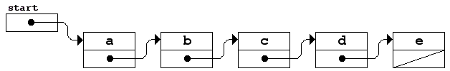
List-Based Buffers
The list-based model of the EditorBuffer class uses pointers to indicate the order of characters in the buffer. For example, the buffer containing
is modeled conceptually like this:
The diagonal line through the last link pointer is used in list diagrams to indicate the NULL value that marks the end of the list.
a b c d e

Slide 26
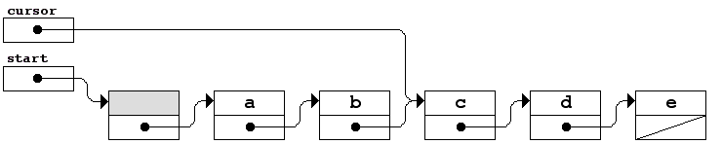
Representing the Cursor
The diagram on the preceding slide did not indicate the cursor position, mostly because doing so is a bit tricky.
If a list contains five cells, as in this example, there are six positions for the cursor. Thus, it is impossible to represent all of the possible positions by pointing to some cell.
One standard strategy for solving this problem is to allocate an extra cell (usually called a dummy cell) at the beginning of the list, and then represent the position of the cursor by pointing to the cell before the insertion point. Thus, if the cursor is between the c and the d, the five-character buffer would look like this:

Slide 27
List Editor Simulation
start
cursor
*
Iacxde
a c x d e
^
*
J
a c x d e
^
a
c
*
F
a c x d e
^
*
Ib
a b c x d e
x
d
e
^
*
F
a b c x d e
^
*
D
b
a b c d e
^
*

Slide 28
Private Data for List-Based Buffer
private:
/*
* Implementation notes
* --------------------
* In the linked-list implementation of the buffer, the characters in the
* buffer are stored in a list of Cell structures, each of which contains
* a character and a pointer to the next cell in the chain. To simplify
* the code used to maintain the cursor, this implementation adds an extra
* "dummy" cell at the beginning of the list. The following diagram shows
* a buffer containing "ABC" with the cursor at the beginning:
*
* +-----+ +-----+ +-----+ +-----+ +-----+
* start | o--+---==>| | -->| A | -->| B | -->| C |
* +-----+ / +-----+ / +-----+ / +-----+ / +-----+
* cursor | o--+-- | o--+-- | o--+-- | o--+-- | / |
* +-----+ +-----+ +-----+ +-----+ +-----+
*/
struct Cell {
char ch;
Cell *link;
};
/* Data fields required for the linked-list representation */
Cell *start; /* Pointer to the dummy cell */
Cell *cursor; /* Pointer to cell before cursor */

Slide 29
List-Based Buffer Implementation
/*
* File: buffer.cpp (list version)
* -------------------------------
* This file implements the EditorBuffer class using a linked
* list to represent the buffer.
*/
#include <iostream>
#include "buffer.h"
using namespace std;
/*
* Implementation notes: EditorBuffer constructor
* ----------------------------------------------
* This function initializes an empty editor buffer represented as a
* linked list. In this representation, the empty buffer contains a
* "dummy" cell whose ch field is never used. The constructor must
* allocate this dummy cell and set the internal pointers correctly.
*/
EditorBuffer::EditorBuffer() {
start = cursor = new Cell;
start->link = NULL;
}

Slide 30
List-Based Buffer Implementation
/*
* Implementation notes: EditorBuffer destructor
* ---------------------------------------------
* The destructor must delete every cell in the buffer. Note that the loop
* structure is not exactly the standard for loop pattern for processing
* every cell within a linked list. The complication that forces this
* change is that the body of the loop can't free the current cell and
* later have the for loop use the link field of that cell to move to
* the next one. To avoid this problem, this implementation copies the
* link pointer before calling delete.
*/
EditorBuffer::~EditorBuffer() {
Cell *cp = start;
while (cp != NULL) {
Cell *next = cp->link;
delete cp;
cp = next;
}
}
/*
* File: buffer.cpp (list version)
* -------------------------------
* This file implements the EditorBuffer class using a linked
* list to represent the buffer.
*/
#include <iostream>
#include "buffer.h"
using namespace std;
/*
* Implementation notes: EditorBuffer constructor
* ----------------------------------------------
* This function initializes an empty editor buffer represented as a
* linked list. In this representation, the empty buffer contains a
* "dummy" cell whose ch field is never used. The constructor must
* allocate this dummy cell and set the internal pointers correctly.
*/
EditorBuffer::EditorBuffer() {
start = cursor = new Cell;
start->link = NULL;
}

Slide 31
List-Based Buffer Implementation
void EditorBuffer::moveCursorForward() {
if (cursor->link != NULL) {
cursor = cursor->link;
}
}
void EditorBuffer::moveCursorBackward() {
Cell *cp = start;
if (cursor != start) {
while (cp->link != cursor) {
cp = cp->link;
}
cursor = cp;
}
}
void EditorBuffer::moveCursorToStart() {
cursor = start;
}
void EditorBuffer::moveCursorToEnd() {
while (cursor->link != NULL) {
moveCursorForward();
}
}
/*
* Implementation notes: EditorBuffer destructor
* ---------------------------------------------
* The destructor must delete every cell in the buffer. Note
* that the loop structure is not exactly the standard idiom for
* processing every cell within a linked list, because it is not
* legal to delete a cell and later look at its link field. To
* avoid selecting fields in the structure after it has been
* deallocated, you have to copy the link pointer before calling
* delete.
*/
EditorBuffer::~EditorBuffer() {
Cell *cp = start;
while (cp != NULL) {
Cell *next = cp->link;
delete cp;
cp = next;
}
}

Slide 32
List-Based Buffer Implementation
void EditorBuffer::moveCursorForward() {
if (cursor->link != NULL) {
cursor = cursor->link;
}
}
void EditorBuffer::moveCursorBackward() {
Cell *cp = start;
if (cursor != start) {
while (cp->link != cursor) {
cp = cp->link;
}
cursor = cp;
}
}
void EditorBuffer::moveCursorToStart() {
cursor = start;
}
void EditorBuffer::moveCursorToEnd() {
while (cursor->link != NULL) {
moveCursorForward();
}
}
/*
* Implementation notes: insertCharacter, deleteCharacter
* ------------------------------------------------------
* The primary advantage of the linked list representation for
* the buffer is that the insert and delete operations can be
* performed in constant time by updating pointers instead of
* moving data.
*/
void EditorBuffer::insertCharacter(char ch) {
Cell *cp = new Cell;
cp->ch = ch;
cp->link = cursor->link;
cursor->link = cp;
cursor = cp;
}
void EditorBuffer::deleteCharacter() {
if (cursor->link != NULL) {
Cell *oldcell = cursor->link;
cursor->link = oldcell->link;
delete oldcell;
}
}

Slide 33
Pointers
Flashback
In C++, pointers serve several purposes, of which the following are the most important:
Pointers allow you to refer to a large data structure in a compact way. Because a memory address typically fits in a few bytes of memory, this strategy offers considerable space savings when the data structures themselves are large. E.g., call by pointers.
Pointers make it possible to reserve new memory during program execution. In many applications, it is convenient to acquire new memory as the program runs and to refer to that memory using pointers, which is called dynamic allocation.
Pointers can be used to record relationships among data items. Data structures that use pointers to create connections between individual components are called linked structures. Programmers can indicate that one data item follows another in a conceptual sequence by including a pointer to the second item in the internal representation of the first.

Slide 34
Complexity of the Editor Operations
array
list
stack
F
moveCursorForward()
O(1)
O(1)
O(1)
B
moveCursorBackward()
O(1)
O(N)
O(1)
J
moveCursorToStart()
O(1)
O(1)
O(N)
E
moveCursorToEnd()
O(1)
O(N)
O(N)
I
insertCharacter(ch)
O(N)
O(1)
O(1)
D
deleteCharacter()
O(N)
O(1)
O(1)
The complexity of the stack-based operations may not be as straightforward as it appears, because it depends on the complexity of the operations of the CharStack, such as push and pop.

Slide 35
Amortized Analysis
Worst-case analysis of run time complexity is often too pessimistic.
Average-case analysis may be diﬃcult. What is “average”? “Random” might not be “average”. Probabilistic analysis is often involved.
In an amortized analysis, we average the time required to perform a sequence of data-structure operations over all the operations performed.
With amortized analysis, we can show that the average cost of an operation is small, if we average over a sequence of operations, even though a single operation within the sequence might be expensive.
Amortized analysis differs from average-case analysis in that probability is not involved; an amortized analysis guarantees the average performance of each operation in the worst case.

Slide 36
Mathematics of the Doubling Strategy
The collection classes in this text all use the strategy of doubling their capacity whenever the structure runs out of room. Doing so guarantees that the amortized cost of inserting elements is O(1).
If α is the cost of an insertion that doesn’t expand the capacity and β is the per-element cost of the linear expansion, the total cost of inserting N items is:
Dividing by N gives the average time, as follows:
The sum in parentheses is always less than two, so the average time is constant.

Slide 37

Complexity of the Editor Operations
Is it possible to reimplement the editor buffer so that all six of these operations run in constant time?
The answer is yes, but “there ain't no such thing as a free lunch”, so what is the price one has to pay?
Time-space tradeoffs: doubly linked lists

Slide 38
The End

